Slide 1
HNDIT2417
Mobile Application Development
Application Components

Slide 2
Main Application Components
Activity:
  A single screen that’s visible to user
Service:
  Long-running background operation of app
ContentProvider:
  Supplies data from one application to others on request.
BroadcastReceiver:
  Deceive and respond to broadcast messages from other applications or from the system.

Slide 3
Additional Components
Intent - Message objects that make a request to the Android runtime to start an activity or other app component
  Explicit Intent
  Implicit Intent

Slide 4
Activity
One screen of the Android app's user interface.

Slide 5
Activity
User interface screen
Application can have one or more activities
Activities extends Context class, so activities can used to get global information of app

Slide 6
Activity Life Cycle
Developer do not have any control over activity state.
Activity state are managed by system.
Dalvik VM can stop any Activity without warning!
Activity save it’s own state , so it can be restored later in application life cycle.

Slide 7
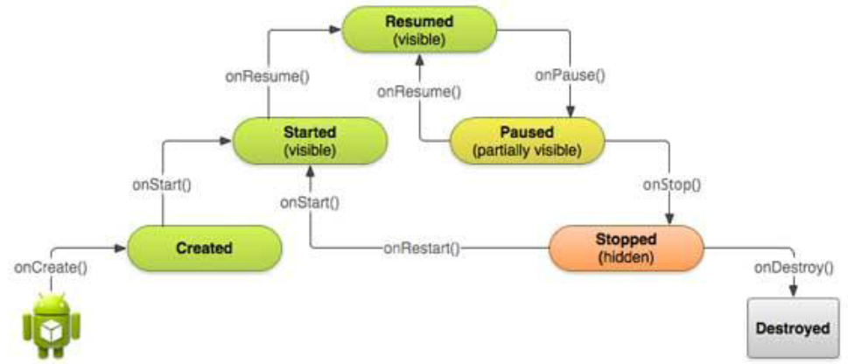
Activity Life Cycle – State Diagram

Slide 8
Callback methods
Method that gets called when an event occurs
Callback method | Description
onCreate() | First callback and called when the activity is first created.
onStart() | Called when the activity becomes visible to the user
onResume() | Called when the user starts interacting with the application. the activity is now at the top of the activity stack and is the activity with which the user is currently interacting.
onRestart() | Called when the activity restarts after stopping it

Slide 9
Callback methods
Method that gets called when an event occurs
Callback method | Description
onPause() | called when the current activity is being paused and the previous activity is being resumed.
onStop() | called when the activity is no longer visible
onDestroy() | called before the activity is destroyed by the system

Slide 10
Activity Lifetimes
Entire Lifetime – The term “entire lifetime” is used to describe everything that takes place within an activity between the initial call to the onCreate() method and the call to onDestroy() prior to the activity terminating.
Visible Lifetime – Covers the periods of execution of an activity between the call to onStart() and onStop(). During this period the activity is visible to the user though may not be the activity with which the user is currently interacting.
Foreground Lifetime – Refers to the periods of execution between calls to the onResume()and onPause() methods.

Slide 11
Service
Service is a component that runs in the background to perform long-running operations without needing to interact with the user.
  Example
    Play music in the background
    Fetch data over the network

Slide 12
Service Life Cycle – States
Started
  A service is started when an application component, such as an activity, starts it by calling startService().
  Once started, a service can run in the background indefinitely, even if the component that started it is destroyed.
  So use stopSelf() or stopService()to stop

Slide 13
Service Life Cycle – States
Bound
  A service is bound when an application component binds to it by calling bindService().
  A bound service offers a client-server interface that allows components to interact with the service, send requests, get results, and even do so across processes with inter-process communication (IPC).

Slide 14
Callback methods
Callback method | Description
onStartCommand() | called when another component, requests the service by calling startService().
onBind() | called this method when another component wants to bind with the service by calling bindService().
onUnbind() | called when all clients have disconnected from a particular interface published by the service
onRebind() | when new clients have connected to the service, after it had previously been notified that all had disconnected in its onUnbind(Intent).
onCreate() | when the service is first created using onStartCommand() or onBind().
onDestroy() | when the service is is being destroyed.

Slide 15
Broadcast Receivers
Android component which allows you to send or receive Android system or application events.

Slide 16
Broadcast Receivers
Respond to broadcast messages from other applications or from the system.
  Steps to make Broadcast Receiver work
    Creating the Broadcast Receiver.
    Registering Broadcast Receiver
A broadcast receiver is implemented as a subclass of BroadcastReceiver class and overriding the onReceive() method where each message is received as an Intent object parameter.

Slide 17
Broadcast Receivers
public class MyReceiver extends BroadcastReceiver
{
@Override
public void onReceive(Context context, Intent intent)
{
……
}
}

Slide 18
Registering Broadcast Receiver
Application listens for specific broadcast intents by registering a broadcast receiver in AndroidManifest.xml file.
<application
<receiver android:name="MyReceiver">
<intent-filter>
<action android:name="android.net.conn.CONNECTIVITY_CHANGE">
</action>
</intent-filter>
</receiver>
</application>

Slide 19
Few Broadcast Event Constants
android.intent.action.BATTERY_LOW
android.intent.action.BATTERY_OKAY
android.net.conn.CONNECTIVITY_CHANGE

Slide 20
Content Providers
Supplies data from one application to others on request.

Slide 21
Content Providers
Each Android applications runs in its own process with keeps application data hidden from another application
Sometimes it required to share data across applications
Content Providers centralize content in one place and have many different applications access

Slide 22
Content Providers
Content provider behaves very much like a database where you can query it, edit its content, as well as add or delete content

Slide 23
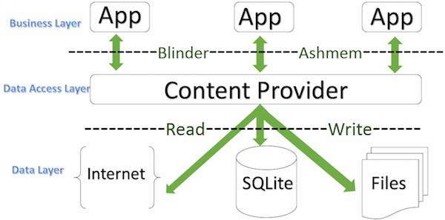
Content Providers

